Slide 1
Employee performance analysis using Excel
STUDENT NAME : VIDYADHAR.S REGISTER NO : 312207182 NM ID :C28A17889CA4D6E809C4F68FA7668857 DEPARTMENT : B.COM(MM) COLLEGE : A.M.JAIN COLLEGE

Slide 2


Slide 3


Slide 4


Slide 5


Slide 6


Slide 7
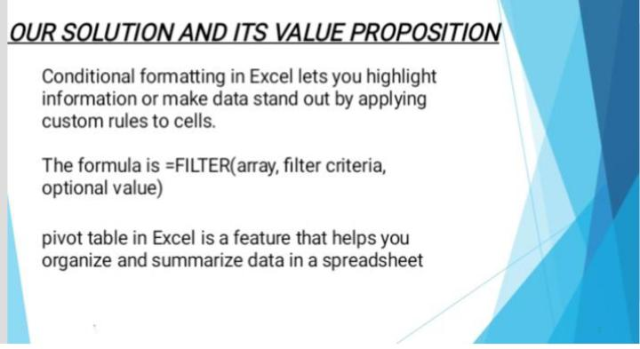

Slide 8
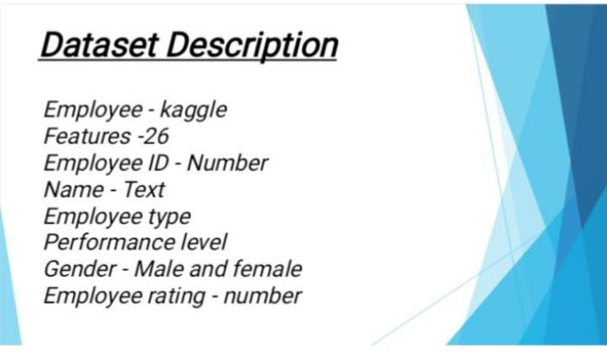

Slide 9


Slide 10
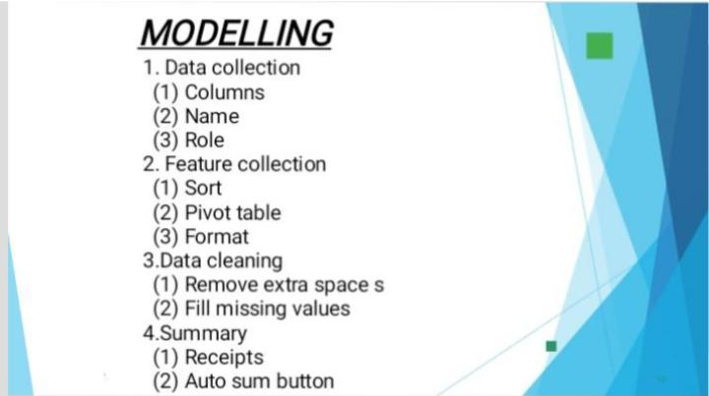

Slide 11
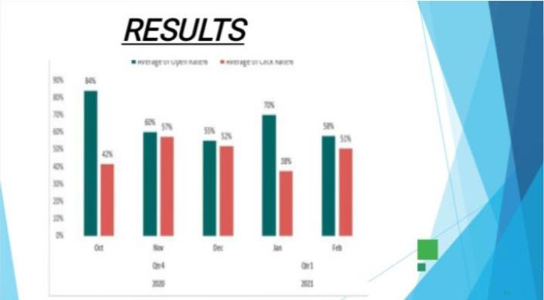

Slide 12


